Slide 1
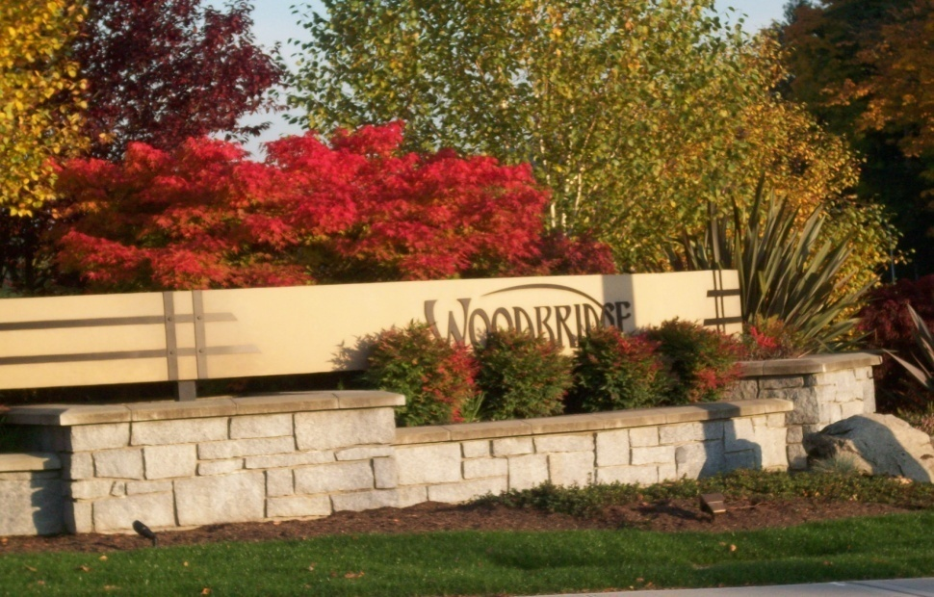

2026 Annual General Membership
Meeting
Homeowners Association
2026
Js
Meeting Date: Jan 18 2026

Slide 2
Agenda
Introduction
Financials
Community Updates
Call for Action
Reminders
Open Floor

Slide 3
Introduction
Total Homes - 346
Single Family Homes - 280; Townhomes - 66
Board of Directors
President - Brad Halbach
Co-Vice President - Geetika Sheokand
Co-Vice President - TBD
Treasurer - Ajay Gupta
Secretary - Ian Mcintyre

Slide 4
Board Chairs and Volunteers
Neighborhood Safety Chair - Srikanth Manohar
Pond and Fountain Maintenance Chair - Terry G
Escrow Approval Chair - Brad H
Landscape Irrigation Chair - Arun
Landscaping Chair - Geethika S
Architectural Committee Chair & Legal Questions Adviser- Ian
AppFolio Communications Chair - Arun & Ajay
Rules Enforcement - Ian
Social Event Logistics Chair - Brad
Playground Garbage Attendant - Isaac
Playground Garbage Monitor - Ian
(New) Woodbridge Residents Only (Vetted) WhatApp Group Admin - Co-managed by Neighborhood Watch Street Captains
Woodbridge Facebook Page Admin - Dan (Privately Managed/Moderated)

Slide 5
Financials

Slide 6
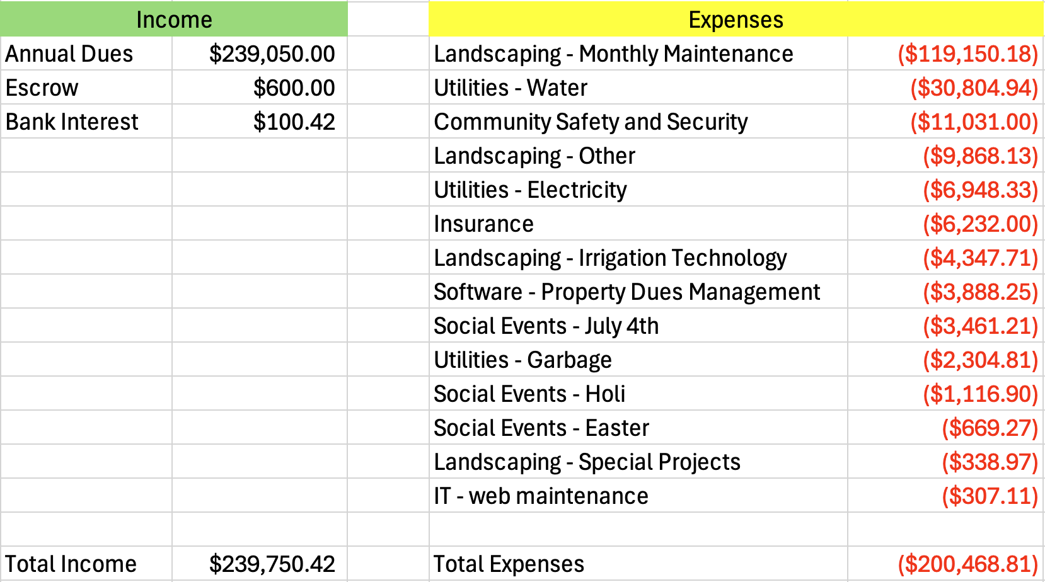
2025 Statement of Financial Activity

Slide 7
2026 Budget
Expected Income | $ 240,000
Expected Expenses | Amount $
Landscape - Maintenance | $ 120,000
Landscape – Mulching | $ 20,000
Landscape - Special Projects | $ 20,000
Landscape - Irrigation repairs | $ 10,000
Utilities (Water + Electricity + Stormwater) | $ 45,000
Pond Fountain Maintenance | $ 15,000
Play Structure Replacement Fund | $ 10,000
Sidewalk Tree Replacement Fund | $ 5,000
Insurance, Appfolio, Property Tax, Website, Events | $ 15,000
Total Budgeted Expenses | $ 260,000
Notes:
Landscaping - Special Projects:

Slide 8
Assets History
Year to Date Start & End Balances
 | 2021 | 2022 | 2023 | 2024 | 2025 | 2026*
Assets at the start | $222,069.60 | $198,089.06 | $267,314.85 | $309,601.68 | $353,766.40 | $393,048.01
Income | $181,831.12 | $262,458.31 | $238,966.39 | $244,161.69 | $239,750.42 | $240,000.00
Expenses | $205,765.15 | $193,232.52 | $196,679.56 | $223,716.57 | $200,468.81 | $260,000.00
Assets at the end | $198,089.06 | 267,314.85 | $309,601.68 | $353,766.40 | $393,048.01 | $373,048.01
Legend:
* - Estimates
Assets as of Dec 31, 2025

Slide 9
Annual HOA Dues for 2026
Unchanged
Single Family Dues $750 same as last year
Townhome Dues $450 same as last year
HOA Dues Payment Portal: https://woodbridgehoa.appfolio.com/connect/
Due Payments are Due by - Jan 31 2026

Slide 10
HOA Portals
HOA Dues Payment Portal
https://woodbridgehoa.appfolio.com/connect/
Woodbridge HOA Website
http://www.woodbridgeowners.com/
Community Discussion Group (Subscribe from HOA Website)
woodbridgeowners@googlegroups.com
HOA Board of Directors Contact e-mail directors@woodbridgeowners.com

Slide 11
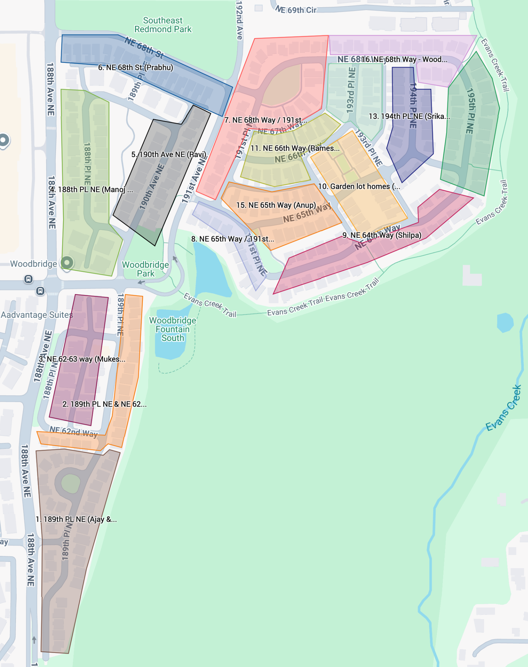
Neighborhood Watch Program (Community Driven)
15 Neighborhood WhatsApp groups for fast and focused communication among residents
WhatsApp groups managed by select volunteers (Captains) who ensure membership and management
All WhatsApp group part of the Woodbrige WhatsApp ‘Community’
https://www.google.com/maps/d/edit?mid=1Dzw27tC4CFOGTH1PJWEux4JH6oYfZ4yY&usp=sharing

Slide 12
Community
Updates

Slide 13
Flock Camera Update
Status
Legal & Political Impacts
Steps Moving forward.
Current Status: The camera program remains suspended.
Strategic Opportunity: The upcoming Committee meeting presents our next window to restore this to the active agenda. However, there's a developing dynamic we need to leverage: Council appears to be positioning this decision around the outcome of the ALPR bill in this legislative session.
Critical Action Items:
Mobilize Public Presence: We need voices beyond mine in the room. Council responds to constituent pressure, especially when it comes from multiple angles during public comment.
In-person testimony at public comment (highest impact)
Direct emails to mayorcouncil@redmond.gov (documents public support)
Direct constituent outreach to our newest members
Focus energy on Council members Vivek Prakriya and Menka Soni. As the newest members, they're still defining their positions and developing their governing philosophy
Legislative waiting games can become indefinite delays. Demonstrated public support now creates political pressure for the Council to act decisively based on the voices of Redmond residents rather than deferring to Olympia.

Slide 14
Ponds and Fountains
Ponds are a important and central part of our community. They do require ongoing maintenance.
Second pond does require some repairs to the fountain.

Slide 15
Beavers (Our Neighbors in the pond)
We have between 4 and 6 beavers.
Meeting with Biologists. Notes & More Info
Protect our larger trees
Re-location is not a good option.
The habitat will likely attract other beavers
Planting event.

Slide 16
Call for Action

Slide 17
Are you looking to get more involved?
What are you passionate about?
Parks, events, administration, social events, safety, security, landscaping, etc.
This is your chance to make a difference in your community!
Influence decisions made by the board
Join us!

Slide 18
Committees: volunteers needed
Pond and Fountain maintenance committee
Landscaping committee
Architectural committee
Enforcement committee
Financial committee
PR/ Events committee
Sidewalk safety committee
Neighborhood Watch Program

Slide 19
Open Floor…
Questions, Clarifications, Comments

Slide 20
Reminders

Slide 21
Garbage Cans Removal Enforcement
Garbage pickup day is Wednesday
The garbage cans need to be put out no earlier than Tuesday
The garbage cans need to be removed by Thursday night
We are going to start giving out fines for garbage cans left on the street on Friday Morning
Warning will be issued and then $25 Fine will be imposed

Slide 22
Home Repainting and Front Lawns Standards
Main fences that have been replaces need to be stained (not painted) with approved stain color
Approved colors schemes for homes and fence can be found at Sherwin-Williams across from Whole Foods (ask to see the Woodbridge bidner)
Shrubs in front or side of the homes need to be trimmed back away from sidewalks (up to six feet high)
Overgrown trees in the front yards need to be trimmed back from sidewalks and homes
Grass on the front lawn need to be cut and maintained weeds free
Weeds that left to grow contaminate community landscape and add labor hours for our community maintenance crew

Slide 23
Parking Enforcement
We continue to receive complaints about cars blocking sidewalks and overnight parking of boat trailers
It is a big safety concern
If your driveway it too short to park your entire car, you can not park there
We will start giving notices to cars that are blocking sidewalks
We will then report violators to Redmond Police Department
Extended overnight parking of boat trailers and RVs are not allowed

Slide 24
City of Redmond Parking Rules
PARKING IS PROHIBITED:
on a sidewalk or street planting strip
within an intersection
on a crosswalk
any place where official signs prohibit parking
in front of or within 5 feet of a driveway
within 15 feet of a fire hydrant
within 20 feet of a crosswalk
within 30 feet of a stop sign, yield sign, traffic signal, or flashing signal
wheels must be parallel to the curb and no more than 12 inches from the curb
A vehicle can park on a public street for no longer than 24 hours, after which time it could be considered a traffic safety hazard or reported as abandoned
http://www.redmond.gov/Transportation/Resources/Parking

Slide 25
Home Structure/Major Landscaping Modifications
If you are modifying your property to conform to the City of Redmond’s sight triangle rules, or for any other reason, please keep in mind our community regulations:
Any major landscaping, architectural changes, decks, and structures over 6 feet tall, must be approved by the Architectural Committee. Please email plans do directors@woodbridgeowners.com
In particular, no fences on corner lots (hedge fences are okay)
See Article 5 of the codes for more details: http://www.woodbridgeowners.com/documents/c-c-and-rs.pdf

